Slide 1
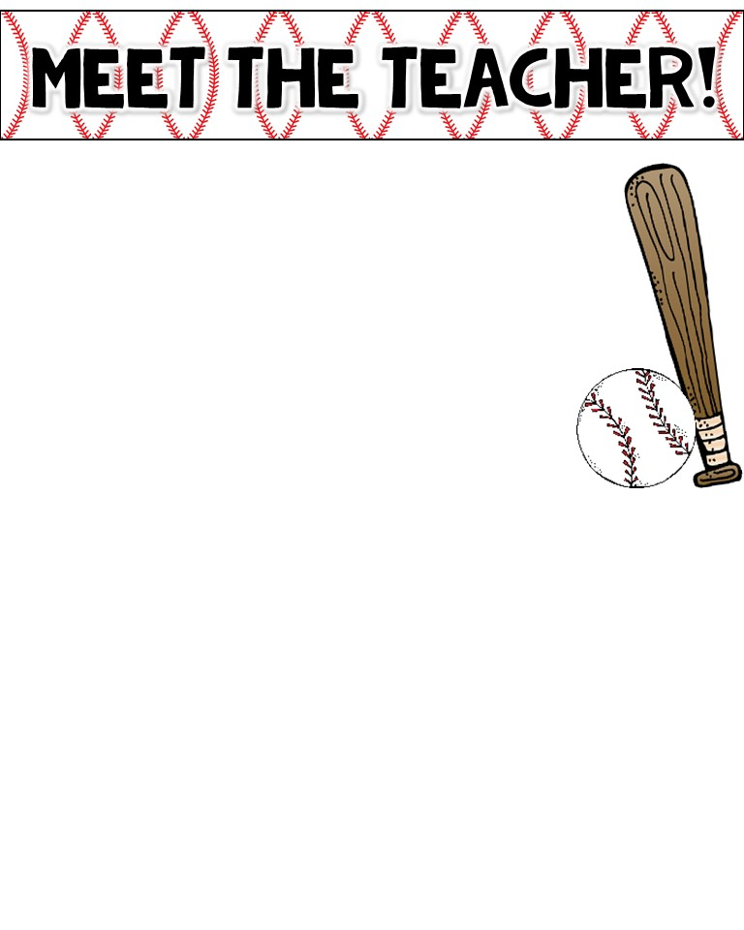
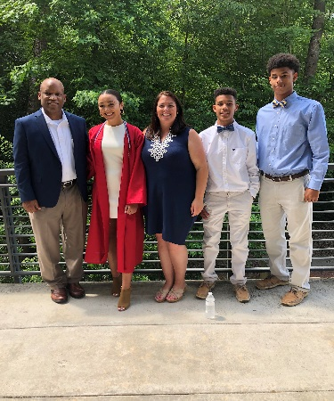
Mrs. Douglas
The Basics!!
Hi! My name is Crystal Douglas and I will be your child’s 3rd grade teacher for the 2019-2020 school year. Here is a little info. about me. I am married and have three children, Olivia, Noah, and Hunter. Also, I have the cutest dog ever named Zoe. I like to travel and spend time with my family and friends! This is my 8th year teaching at Harris Creek and I love it!! Teaching has always been my dream job and I am very excited about the school year!
My Childhood!
I was born in Canton, Ohio but my family moved to Raleigh, NC when I was very young. My parents and sister still live in NC. I attended Wake County Public schools and a private high school in Raleigh. .
!My Favorites
Colors: gray, green, blue, purple; really all the others
Food: Mexican
Drink: Diet Lemonade from Chick-Fil-A
Fast food: Chick-Fil-A
College Team: ECU
Sport: Football
Subject: Literature/History
Hobbies: Baking, reading, attending my children's ball games, going to movies
My Education!
I graduated from East Carolina University with a Bachelor of Science degree in Elementary Education. ARGH, Go Pirates!!
Contact Me!
Email: cdouglas@wcpss.net
Class webpage:
https://mrscdouglas.weebly.com/
School number: 919-217-5100

